Slide 1
SMALL BUSINESS SATURDAY
November 24, 2018

Slide 2
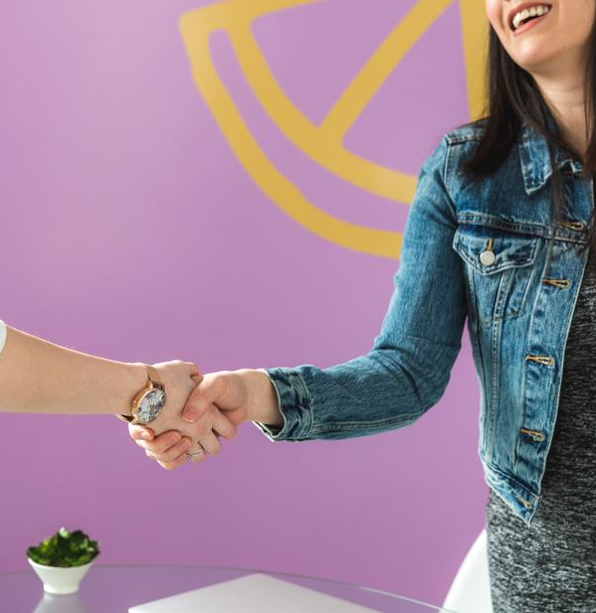
Shop local
When you shop local at a small business, you are supporting your community. Your money goes back to help support other businesses and families. Your tax dollars spent local fund the fire department, roads and schools HERE.

Slide 3

Stop by Balanced Life Massage on Saturday, November 24, 2018 from 10:00am-2:00pm for specials on gift certificates and pre-paid massages for yourself.

